Slide 1
Unicom TIC
Dilujan.P
BICT. (Special) in Software Eng.
Unicom SD Software Engineering

Slide 2
Prerequisites
Familiar with JS syntax
Building logic using JS
Control flow loops

Slide 3
JavaScript Functions
// Function to compute the product of p1 and p2
function myFunction(p1, p2) {
return p1 * p2;
}
// Function is called, the return value will end up in x let x = myFunction(4, 3); function myFunction(a, b) { // Function returns the product of a and b return a * b; }

Slide 4
function toCelsius(fahrenheit) { return (5/9) * (fahrenheit-32); } let value = toCelsius(77);
Accessing a function without () returns the function and not the function result:
function toCelsius(fahrenheit) { return (5/9) * (fahrenheit-32); } let value = toCelsius

Slide 5
Local Variables
// code here can NOT use carName function myFunction() { let carName = "Volvo"; // code here CAN use carName } // code here can NOT use carName

Slide 6

Java Script Error Handling

Slide 7
Catching Errors
When browsing Web pages on the internet, we all have seen a JavaScript alert box telling us there is a runtime error and asking, "Do you wish to debug?".
Error message like this may be useful for developers but not for users.
Two ways of catching errors:
try..catch statement
onerror statement (older solution)

Slide 8
Try...Catch Statement
Syntax
try
{
}
//Run some code here
catch (err)
{
//Handle errors here
}
Note: try..catch is written in lowercase letters. Using uppercase letters will generate a JavaScript error!

Slide 9
<html><head>
<script type="text/javascript"> function message()
{
adddlert("Welcome guest!");
}
</script>
</head>
<body>
<input type="button" value="View message" onclick="message()"
/>
</body>
</html>

Slide 10
<html><head>
<script type="text/javascript">
var txt=“”
function message()
{
try
{ adddlert("Welcome guest!");
}
catch(err)
{ txt="There was an error on this page.\n\n"; txt+="Error description: " + err.message +
"\n\n";
txt+="Click OK to continue.\n\n";
alert(txt);
}
}
</script>
</head><body>
<input type="button" value="View message" onclick="message()" />
</body> </html>

Slide 11
Try...Catch Statement cont…
<html><head>
<script type="text/javascript">
var txt="“
function message()
{
try { adddlert("Welcome guest!");
}
catch(err) {
txt="There was an error on this page.\n\n"; txt+="Click OK to continue viewing this page,\n"; txt+="or Cancel to return to the home page.\n\n"; if(!confirm(txt))
{ document.location.href="http://www.w3schools.com/";
}
}
}
</script>
</head><body>
<input type="button" value="View message" onclick="message()" />
</body></html>

Slide 12
JavaScript Throw Statement
The throw statement allows you to create an exception. If you use this statement together with the try...catch statement, you can control program flow and generate accurate error messages.
Syntax:
throw (exception)
Note: The exception can be a string, integer, Boolean or an object

Slide 13
<html>
<body>
<script type="text/javascript">
var x=prompt("Enter a number between 0 and 10:","");
try
{
if(x>10) throw "Err1"; else if(x<0) throw "Err2";
}
catch(er)
{
if(er=="Err1")
alert("Error! The value is too high"); if(er == "Err2")
alert("Error! The value is too low");
}
</script>
</body>
</html>

Slide 14
The Error Object
JavaScript has a built in error object that provides error information when an error occurs.
The error object provides two useful properties: name and message.

Slide 15
Error Object Properties
Property | Description
name | Sets or returns an error name
message | Sets or returns an error message (a string)

Slide 16
Error Name Values
Error Name | Description
EvalError | An error has occurred in the eval() function
RangeError | A number "out of range" has occurred
ReferenceError | An illegal reference has occurred
SyntaxError | A syntax error has occurred
TypeError | A type error has occurred
URIError | An error in encodeURI() has occurred

Slide 17
JavaScript Debugging
Programming code might contain syntax errors, or logical errors.
Many of these errors are difficult to diagnose.
Often, when programming code contains errors, nothing will happen. There are no error messages, and you will get no indications where to search for errors.
Searching for (and fixing) errors in programming code is called code debugging.

Slide 18
JavaScript Debuggers
Debugging is not easy. But fortunately, all modern browsers have a built-in JavaScript debugger.
Built-in debuggers can be turned on and off, forcing errors to be reported to the user.
With a debugger, you can also set breakpoints (places where code execution can be stopped), and examine variables while the code is executing.
Normally, otherwise follow the steps at the bottom of this page, you activate debugging in your browser with the F12 key, and select "Console" in the debugger menu.

Slide 19
The console.log() Method
If your browser supports debugging, you can use console.log() to display JavaScript values in the debugger window:

Slide 20
Setting Breakpoints
In the debugger window, you can set breakpoints in the JavaScript code.
At each breakpoint, JavaScript will stop executing, and let you examine JavaScript values.
After examining values, you can resume the execution of code (typically with a play button).

Slide 21
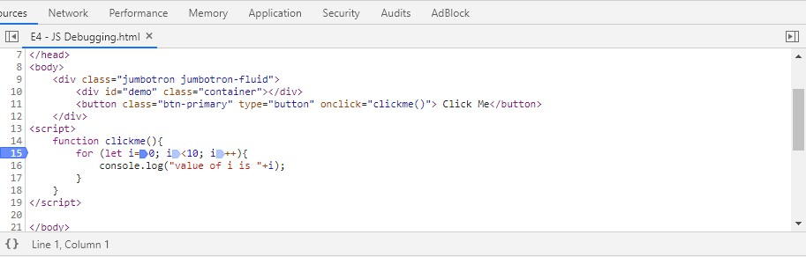
Stepping through the Code
Step Over | F10
Step Into | F11
Step Out | Shift + F11
Continue | F8

Slide 22
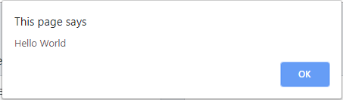
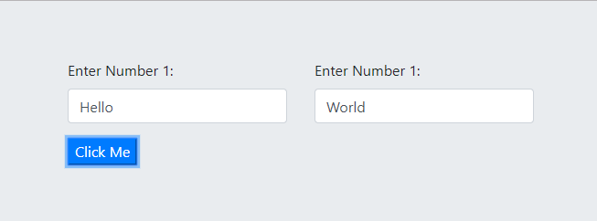
In Class Activity
Write a simple program to concatenate two (2) strings and display it in an alert box as follows:
Use debugging tools to track your code and check how values are changing through the execution.

Slide 23
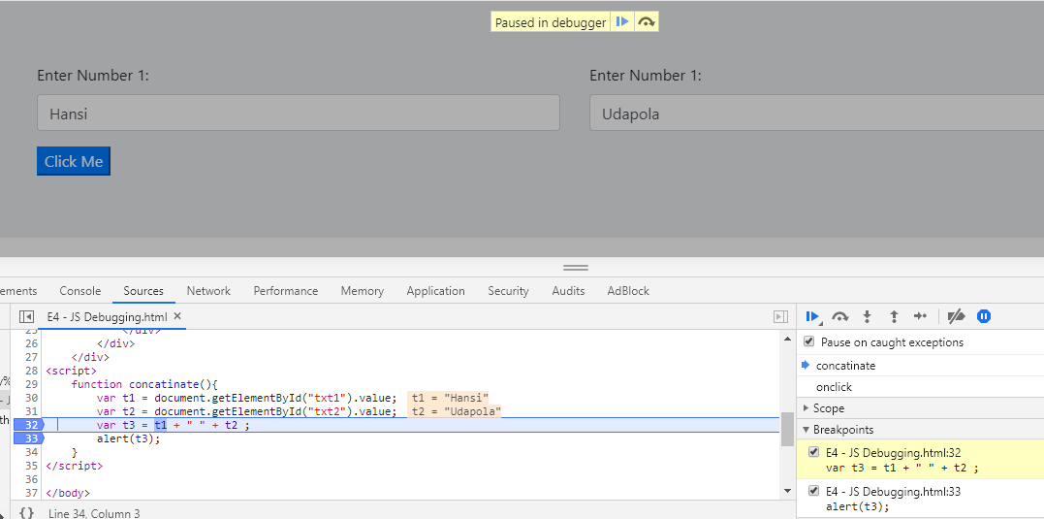

Slide 24
JavaScript Scope
In JavaScript there are two types of scope:
Local scope Global scope
JavaScript has function scope: Each function creates a new scope.
Scope determines the accessibility (visibility) of these variables.
Variables defined inside a function are not accessible (visible) from outside the function.

Slide 25
Local JavaScript Variables
Variables declared within a JavaScript function, become LOCAL to the function.
Local variables have Function scope: They can only be accessed from within the function.
// code here can NOT use carName
function myFunction() {
var carName = "Volvo";
// code here CAN use carName
}

Slide 26
Global JavaScript Variables
A variable declared outside a function, becomes GLOBAL.
A global variable has global scope: All scripts and functions on a web page can access it.
var carName = "Volvo";
// code here can use carName
function myFunction() {
// code here can also use carName
}

Slide 27
Automatically Global
If the assign a value to a variable that has not been declared, it will automatically become a GLOBAL variable.
This code example will declare a global variable carName, even if the value is assigned inside a function.
In "Strict Mode", undeclared variables are not automatically global.
myFunction();
// code here can use carName
function myFunction() { carName = "Volvo";
}

Slide 28
JavaScript Hoisting
In JavaScript, a variable can be declared after it has been used.
In other words; a variable can be used before it has been declared.
Hoisting is JavaScript's default behavior of moving all declarations to the top of the current scope (to the top of the current script or the current function).

Slide 29
JavaScript Initializations are Not Hoisted
var x = 5; // Initialize x y = 7; // Assign 7 to y
elem = document.getElementById("demo"); // Find an element
elem.innerHTML = x + " " + y;
// Display x and y
var x = 5; // Initialize x
var y;
// Declare y
var y; // Declare y
elem = document.getElementById("demo"); // Find an element
elem.innerHTML = x + " " + y;
// Display x and y
var y = 7; // Assign 7 to y
***JavaScript in strict mode does not allow variables to be used if they are not declared.

Slide 30
In Class Activity
What is “Strict Mode”? How do you declare it?
What are the features which are prohibited by the “Strick Mode”?

Slide 31
What is “Strict Mode”? How do you declare it?
Strict mode makes it easier to write "secure" JavaScript because it changes previously accepted "bad syntax" into real errors.
To defines that JavaScript code should be executed in "strict mode, we can use "use strict";
<script>
"use strict";
x = 3.14; // This will cause an error (x is not defined).
</script>

Slide 32
What are the features which are prohibited by the
“Strick Mode”?
Using a variable, without declaring it, is not allowed:
Using an object, without declaring it, is not allowed:
Deleting a variable (or object) is not allowed.
Deleting a function is not allowed.
Duplicating a parameter name is not allowed:
Octal numeric literals are not allowed:
Octal escape characters are not allowed:
Writing to a read-only property is not allowed:
Writing to a get-only property is not allowed:

Slide 33
What are the features which are prohibited by the
“Strick Mode”?
Deleting an undeletable property is not allowed:
The word eval cannot be used as a variable:
The word arguments cannot be used as a variable:
The with statement is not allowed:
For security reasons, eval() is not allowed to create variables in the scope from which it was called:
Keywords reserved for future JavaScript versions can NOT be used as variable names in strict mode.
implements, interface, let, package, private, protected, public, static, yield

Slide 34
JS let & const
ES2015 introduced two important new JavaScript keywords:
let and const.
These two keywords provide Block Scope variables (and constants) in JavaScript.
Before ES2015, JavaScript had only two types of scope:
Global Scope and Function Scope.
Variables declared with the var keyword can not have Block Scope.
Variables declared inside a block {} can be accessed from outside the block.

Slide 35
JS let
Before ES2015 JavaScript did not have Block Scope.
Variables declared with the let keyword can have Block Scope.
Variables declared inside a block {} can not be accessed from outside the block:
{
{
var x = 2;
let x = 2;
}
// x CAN be used here
}
// x can NOT be used here

Slide 36
<!DOCTYPE html>
<html>
<body>
<h2>Declaring a Variable Using let</h2>
<p id="demo"></p>
<script> var x = 10;
// Here x is 10
{
let x = 2;
// Here x is 2
}
// Here x is 10
document.getElementById("demo").innerHTML = x;
</script>
</body>
</html>

Slide 37
JS const
Variables defined with const behave like let variables, except they cannot be reassigned:
const PI = 3.141592653589793;
PI = 3.14;
PI = PI + 10;
// This will give an error
// This will also give an error

Slide 38






Arrow Functions
Arrow functions were introduced in ES6.
Arrow functions allow us to write shorter function syntax:
Before ES6
Arrow functions
hello = function() { return "Hello World!";
hello = () => {
return "Hello World!";
}
}
It gets shorter! If the function has only one statement, and the statement
returns a value, you can remove the brackets and the return keyword:
hello = () => "Hello World!";

Slide 39
In Class Activity
Using Arrow Function, write a function to find the maximum number of a given array.

Slide 40
Objectivity and goal
JavaScript function
Arrow function
Error handling

